Slide 2
WellSoon
Precise and Personalized Chronic Pain Tracking and Management

Slide 3
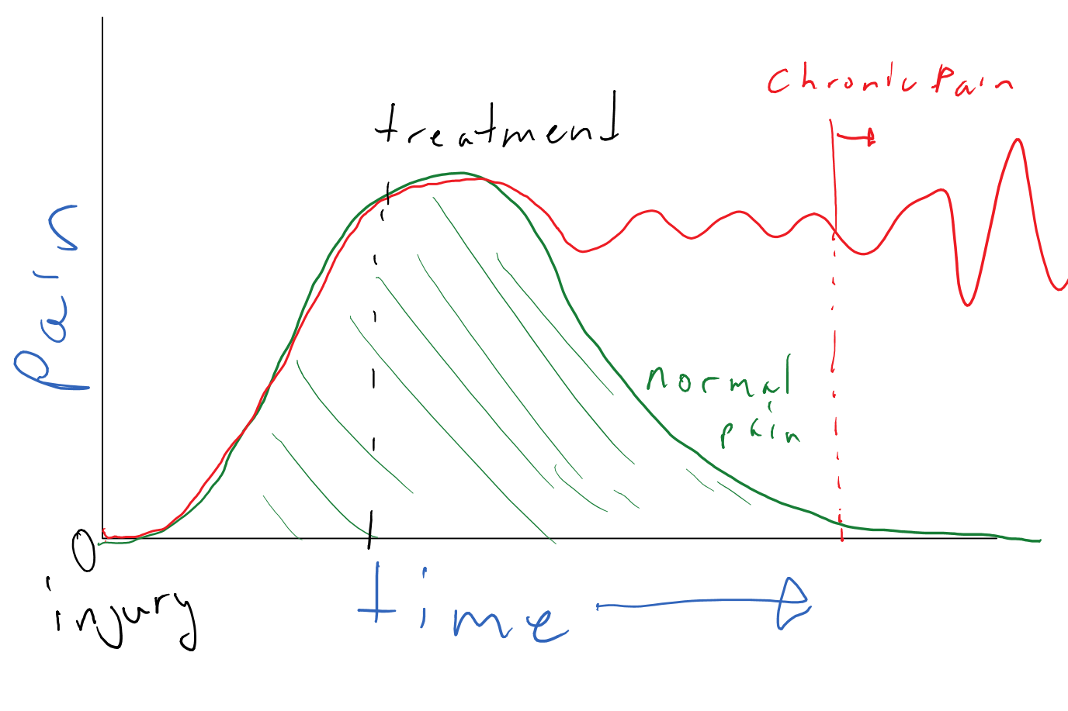
Acute vs. Chronic Pain

Slide 4
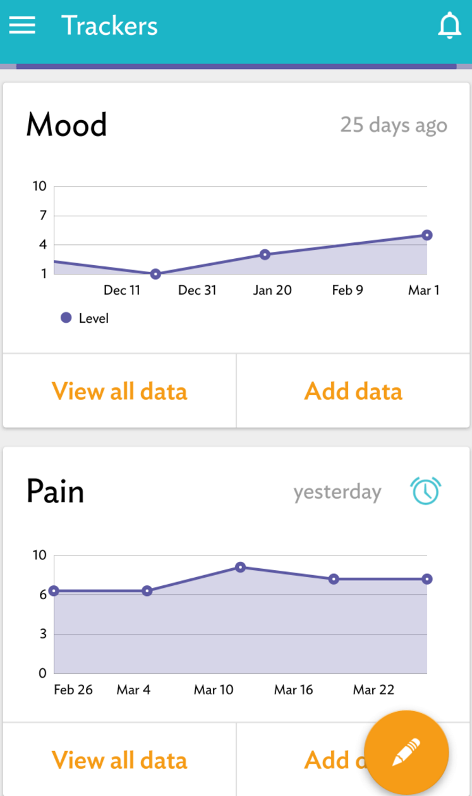
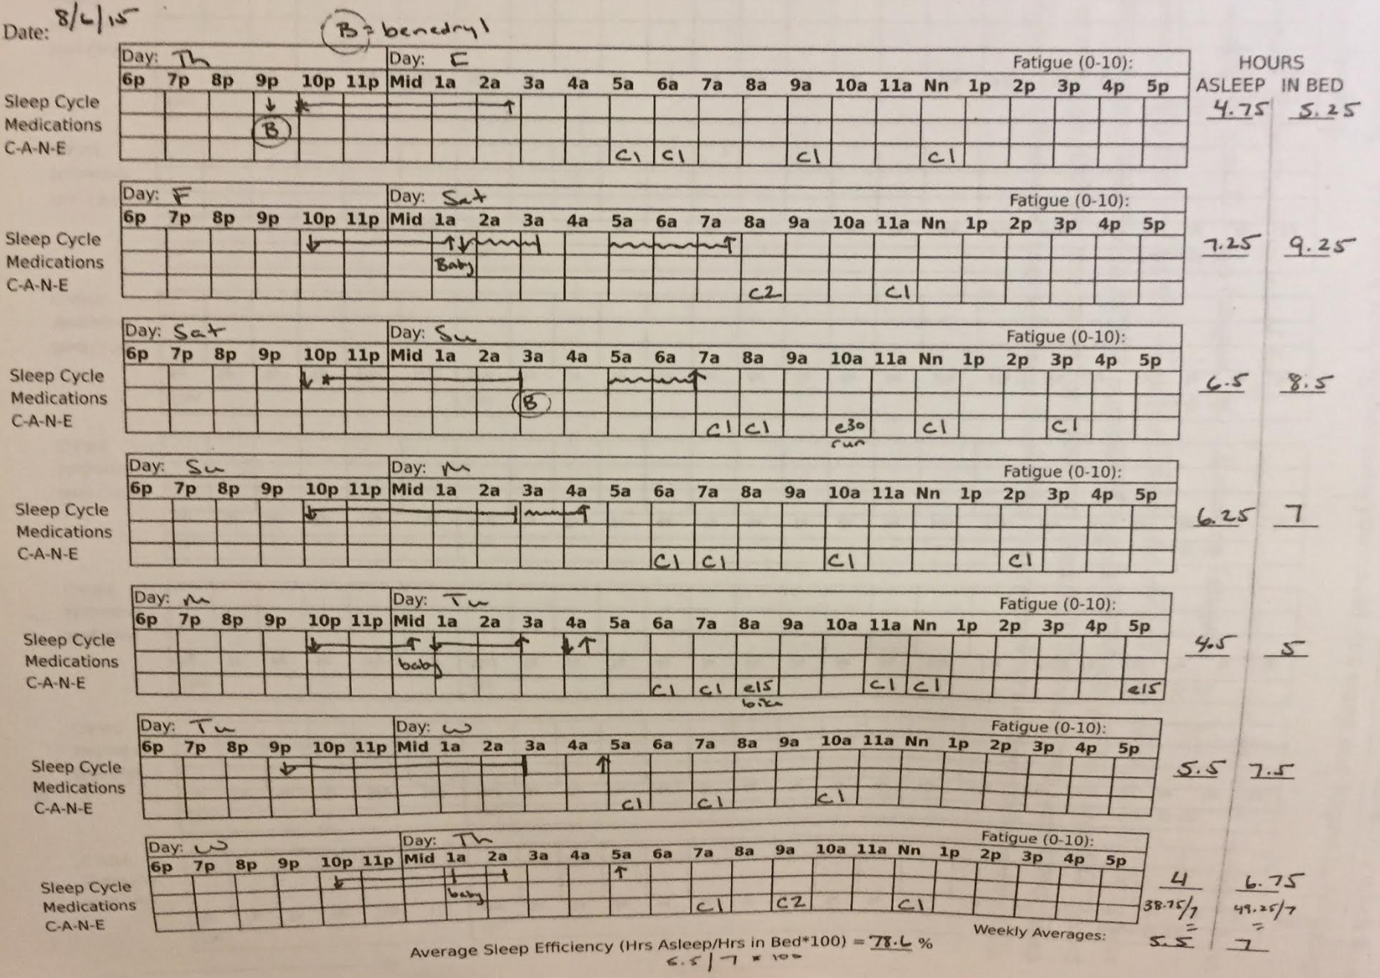
Chronic Pain Tracking and Analysis
1 in 10 americans suffer pain daily 3+ months (NIH)
Cancer, MS, Trauma, AIDS
Current tracking methods:
Memory
Paper/pen
App
(source: patient interviews)
Analysis
Flipping through paper
Treat based on few data points

Slide 5
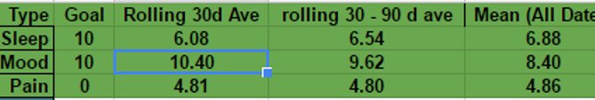
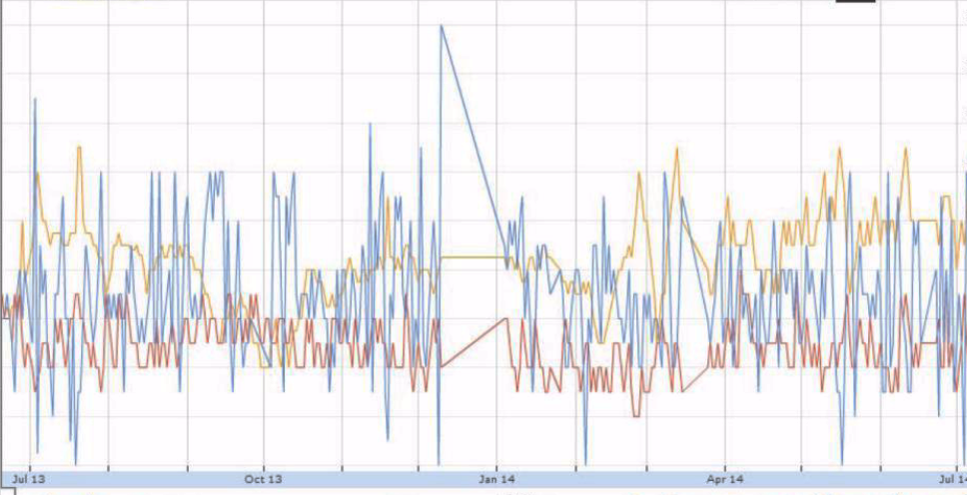
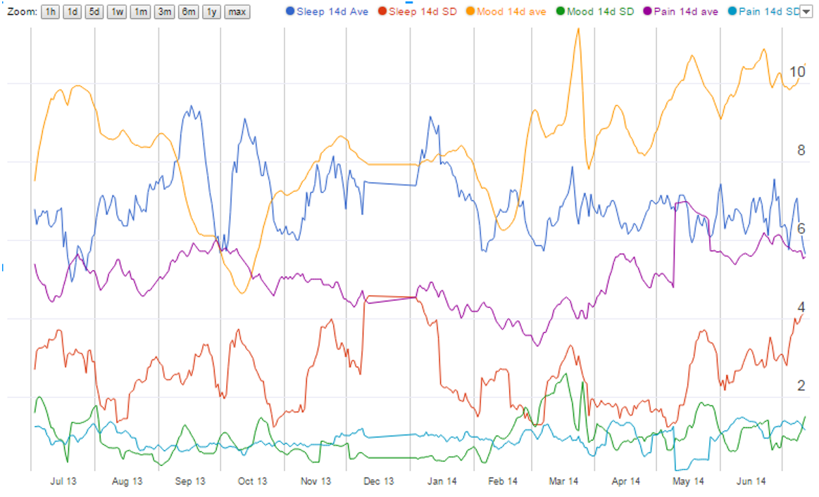
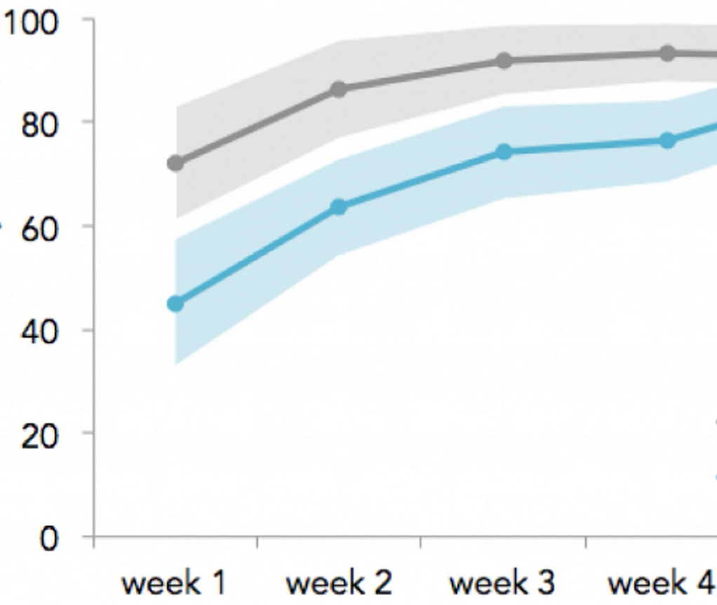
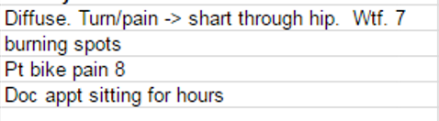
WellSoon - idea
Raw Input Analysis Final output for patient/Doc
Numbers: Pain, etc
Text: Diary, etc.

Slide 6
WellSoon
Low friction data collection
Easy, timely, discrete user input
Subjective
Minimal input
Keep only to subjective metrics
Wearables and other APIs, eg. location, weather
Visualize longer trends meaningfully
Weeks and months
Relational
ML for personalizing alerts for triggers and limits (ML context)
Eg. Dynamic time warping, sentiment score
Eg: X steps so far, Y time left, Z time/activity until unbearable pain

Slide 7
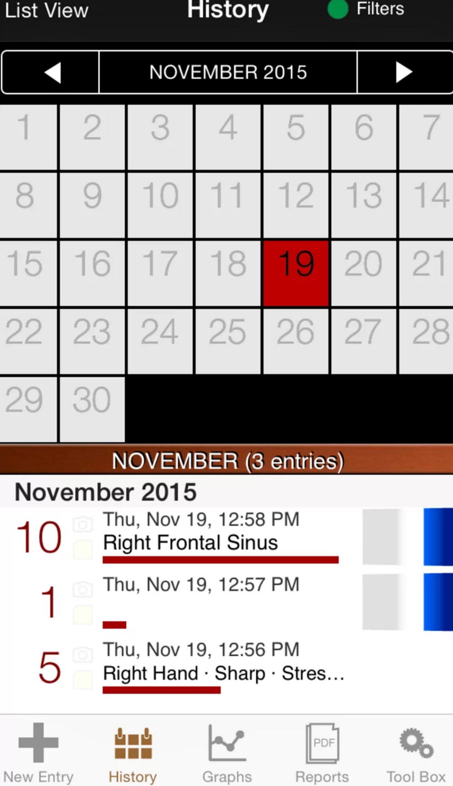
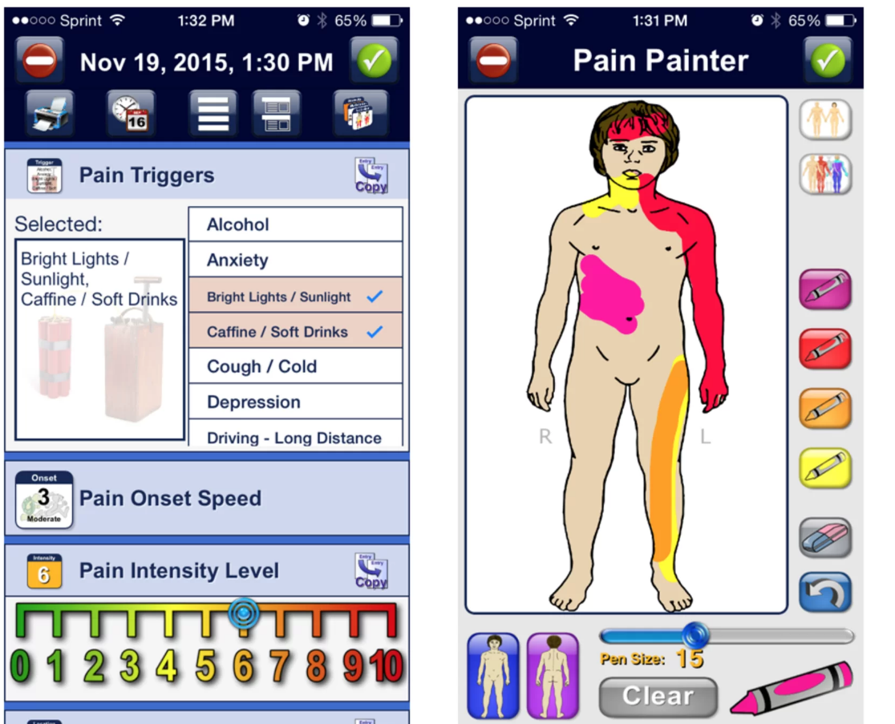
Current Apps
My Pain Diary Chronic Pain Tracker
Others:
CatchMyPain
Manage My Pain
FibroMapp
PMC 320
iBeatPain
Symple
Symbod

Slide 8
Business
B2C Subscription
Customer Segments
+2 Conditions
Neuropathy
Marketing
Clinics & doctor offices
Online ads
Places where chronic pain patients frequent (virtual and in real life)

